Slide 1

Real Time Temperature Display
Lesson 27

Slide 2
Current Temperature Reading
24
Notes:
Change the 24 to the current temperature of the room so that Learners can adjust their program

Slide 3
What the Lesson Will Cover
Recap how the micro:bit can be used to take temperature readings
Create program that uses the Halo to displays the temperature in real time
Adjust the program code to reflect hotter or colder temperatures
Program a real time temperature sensor

Slide 4
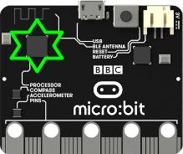
The Temperature Sensor
The microbit module gives you access to all the hardware that is built in to your board
This includes a temperature sensor which can be used to take readings of the immediate surrounding area
The reading is saved can be stored in a variable and the displayed on the LEDs
The program code is simply temperature()
This returns the temperature of the micro:bit in degrees Celsius
Notes:
Explain the basics of the temperature sensor

Slide 5
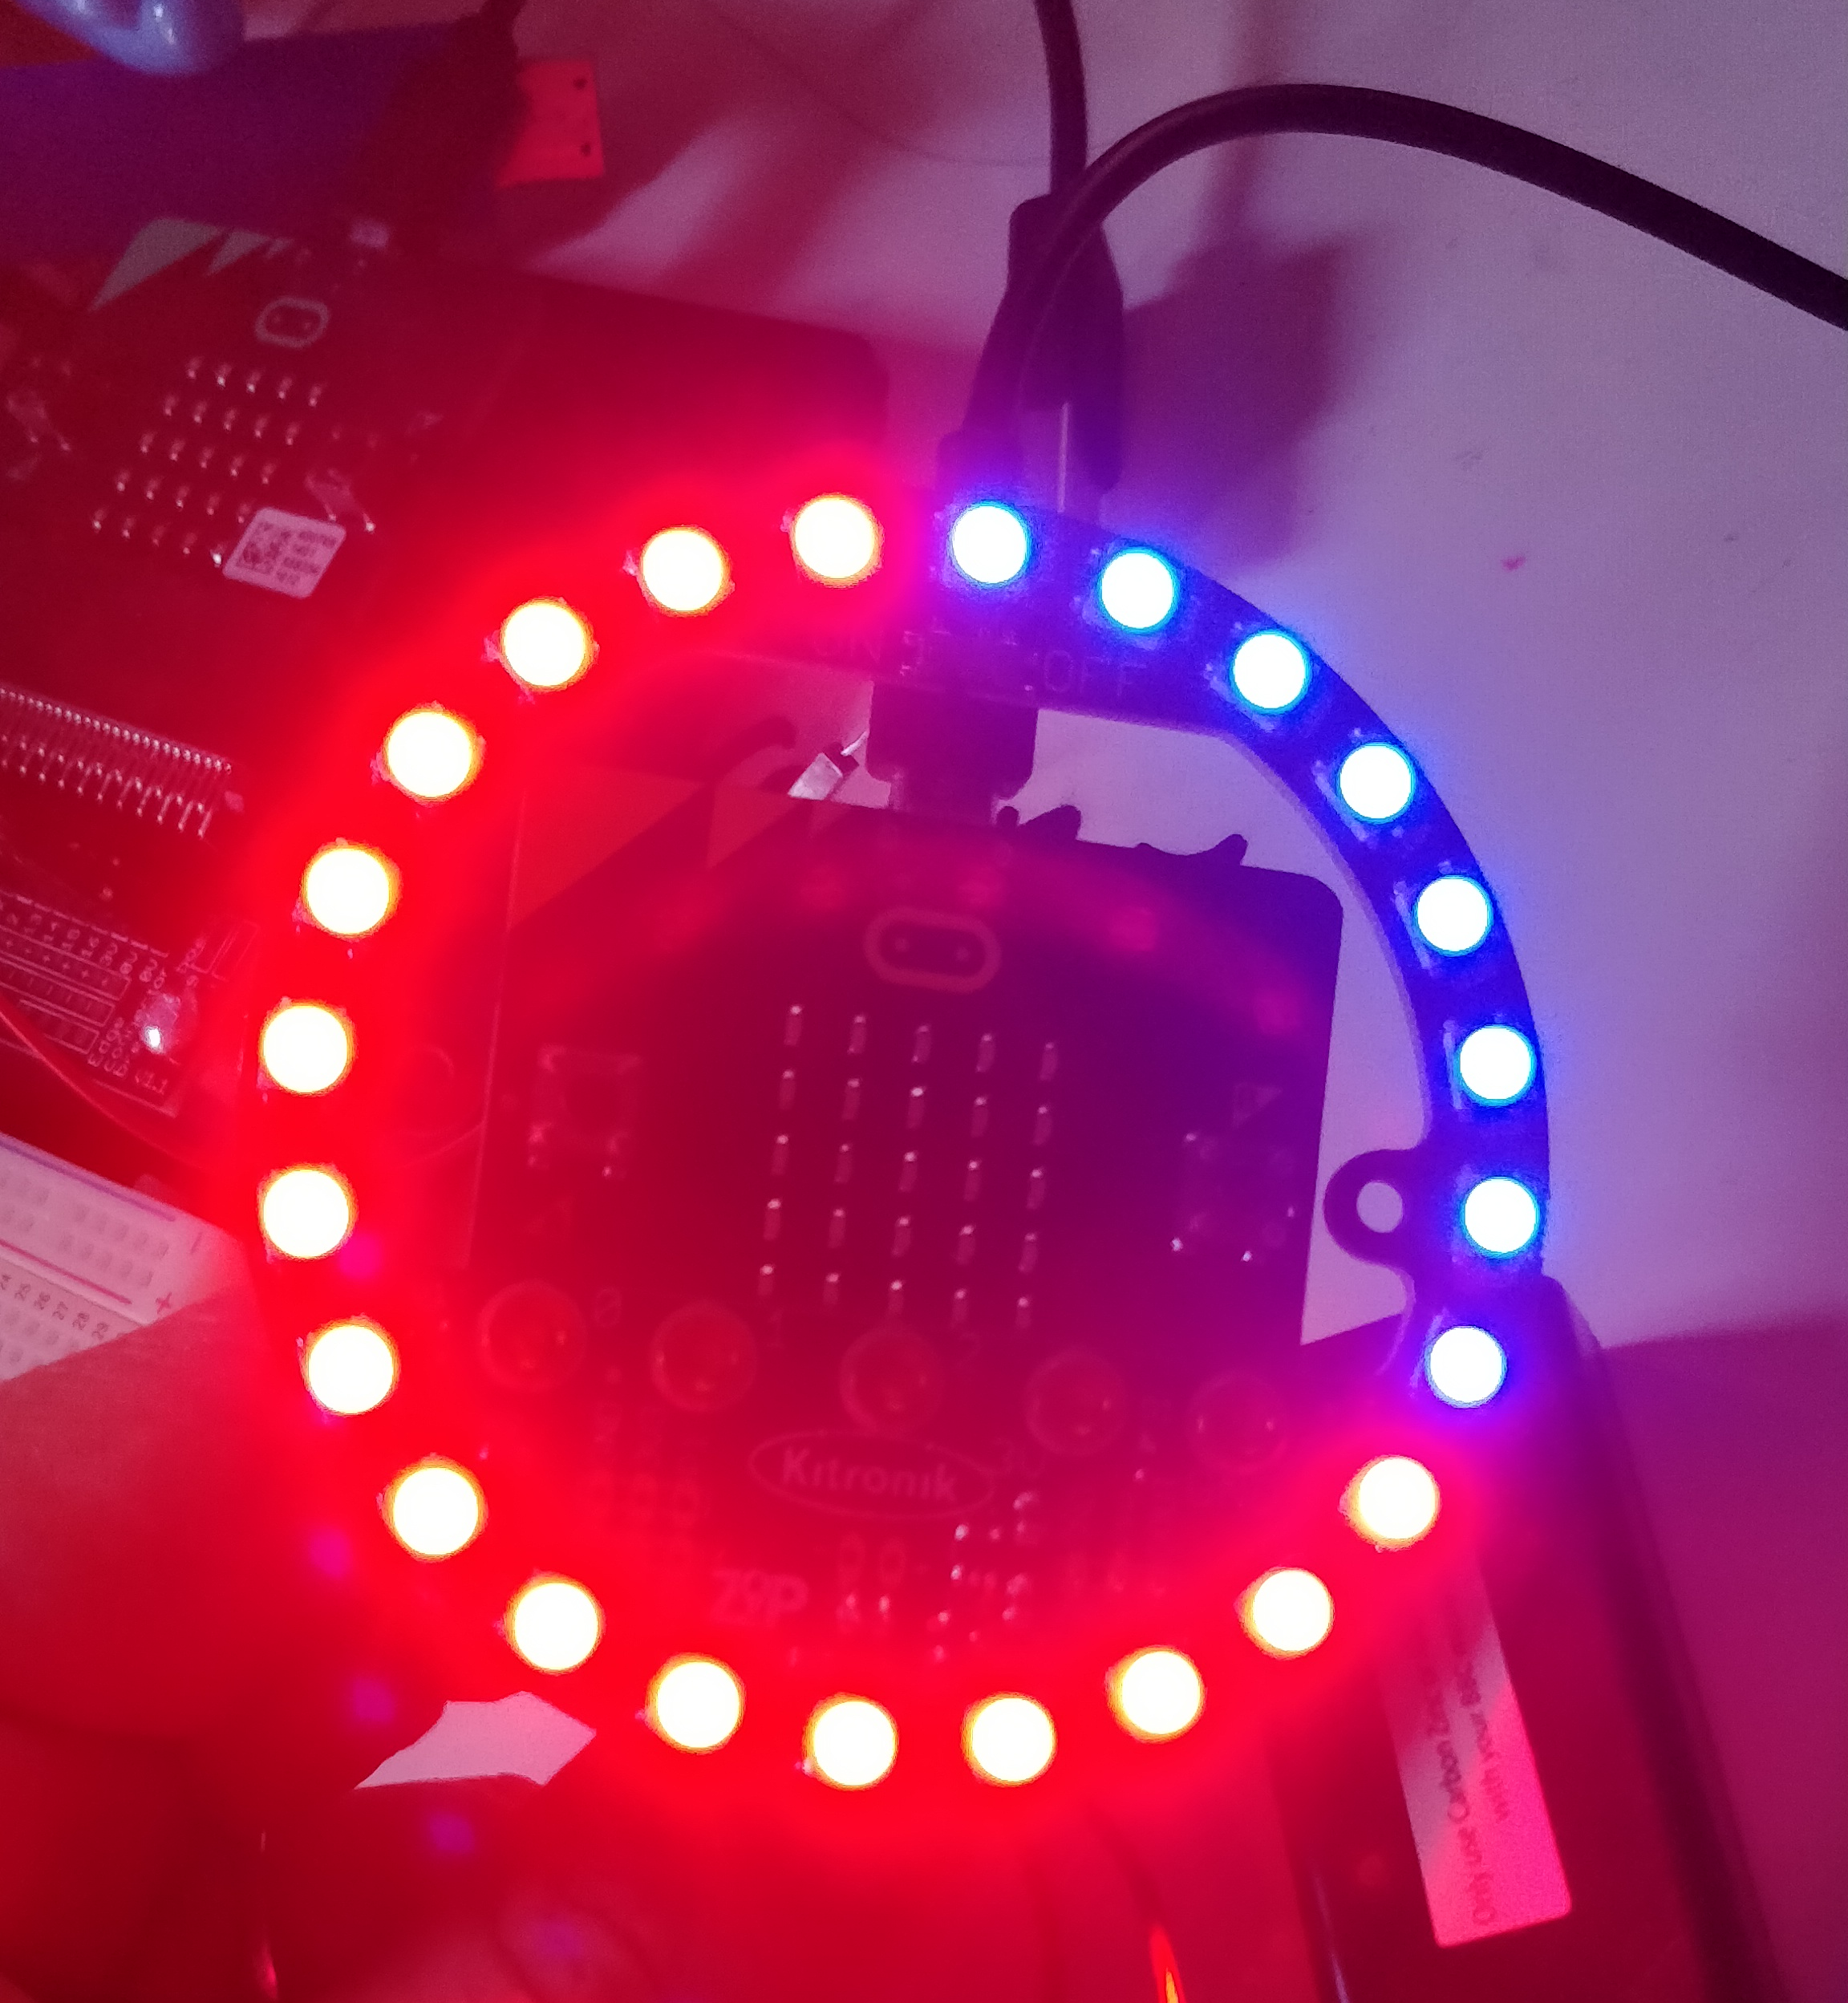
The Halo Real Time Temperature Display
Notes:
Explain how the Halo colours LEDs red to indicate the temperature/
Teacher could demonstrate the display live.

